Slide 1
MIS 3301 Intro. to Business Programming Logic
Input, Processing, and Output
PART 1 - Designing a program, Displaying Output, Strings, Comments, Variables
Mrs. Nancy G. Sánchez

Slide 2
Outline
Designing a program
Displaying Output
Comments
Variables

Slide 3
Designing a Program

Slide 4
Input Process Output (IPO)
1. Input
2. Process
3. Output
What data will your program require?
What processing
is necessary to translate the input into outputs
What must your program produce?
Calculations
Decision logic
Repetition logic
Merging, extracting
etc.

Slide 5
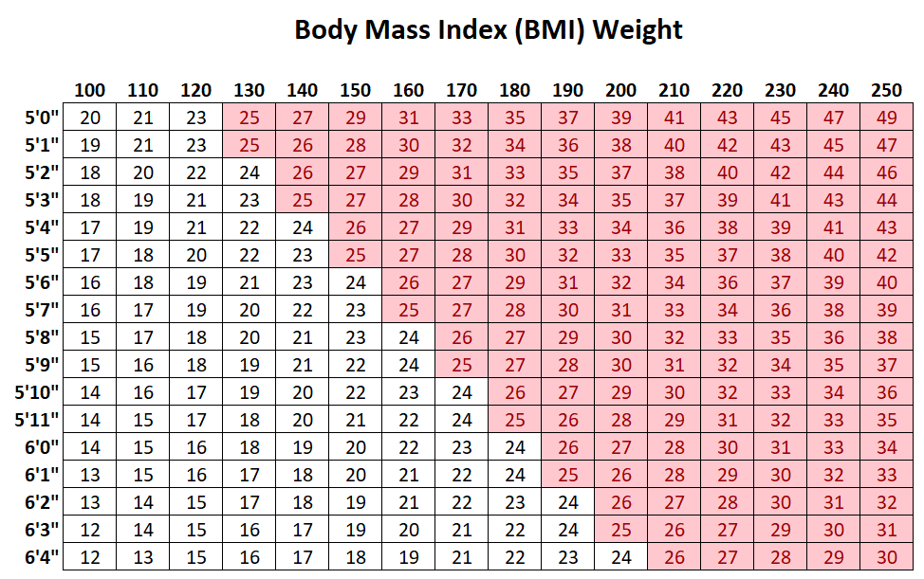
Ex: BMI Project
Goal: Display BMI
BMI Formula
703 x weight (lbs) / [height (in)]2
1. Input
2. Process
3. Output
Algorithm
Get the person’s height.
Get the person’s weight.
Calculate BMI.
Display BMI.
Will need:
height
weight
Processing:
Calc BMI
Goal:
Display BMI

Slide 6
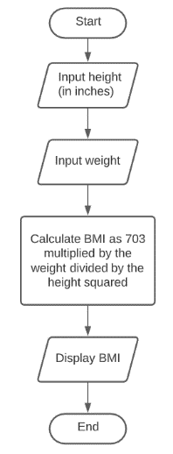
Ex: BMI Project – Design the Problem
Pseudocode
Flowchart
Input height (in inches)
Input the weight (in lbs)
Calculate BMI as 703 multiplied by weight divided by height squared
Display BMI
Terminal
Input
Input
Process
Input
Input
Output
Process
Process
BMI Formula
703 x weight (lbs) / [height (in)]2
Output
Output
Terminal

Slide 7

Program Development Cycle
Program
Specification
Design the Program
Write the Code
Compile the Program
Correct Syntax Errors
Test the Program
Correct Logic Errors
Pseudocode
Flowcharts
Omitted for interpreted language
Correcting code that violates the rules of the language
Correcting code that produces incorrect results

Slide 8
Ch2 - Exercise 1: Hello World

Slide 9
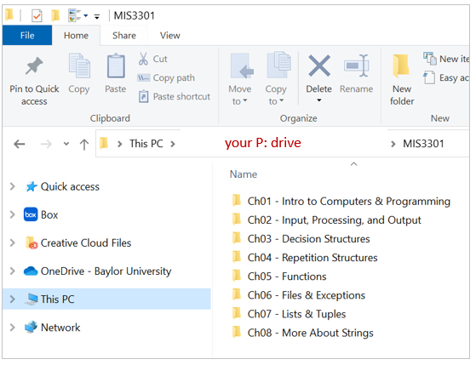
Create Course Folder & Sub-Folders
Create your class folders
Open File Explorer
Create a MIS3301 folder on your P Drive
Go to: H:\MIS3301\3301-Chp-Folders and copy the sub-folders as shown in the screenshot

Slide 10
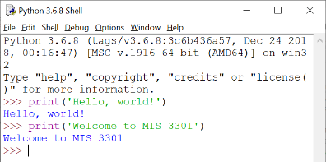
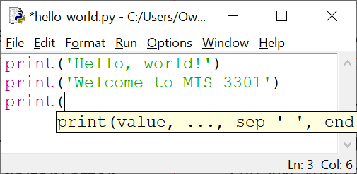
Ch2 - Exercise 1: Hello World
Let’s practice these statements in both IDLE windows
Shell – interactive mode
Text Editor – script mode
Save your program to your: P Drive > Ch2 > Lectures > Ch2-Ex01-HelloWorld.py

Slide 11
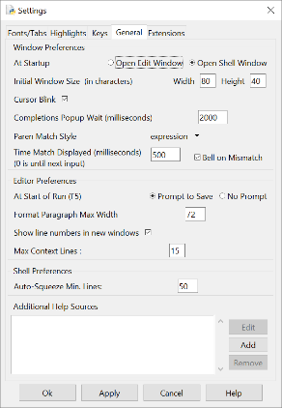
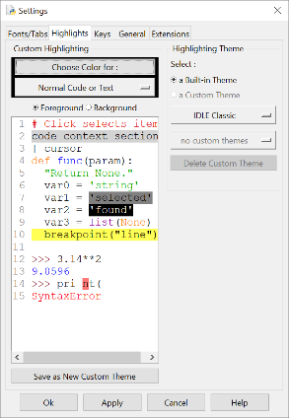
Exercise cont.
Update IDLE settings
Go to Options > Configure IDLE …
General tab > enable Line Numbers
Highlights tab > enable IDLE Dark (Optional)
Change these settings on your laptop as well.

Slide 12
Displaying Output

Slide 13
print() Function
Notes on Functions…
Displays output on the screen
Argument 1
function
argument
func()
Return
Value
…Argument n
print('Hello world')
Function - a piece of prewritten code that performs an operation
Argument – data given to a function
Return value – some functions return a value and other do not.
In this chapter, we are not creating our own functions. Instead, we are using the built-in functions that come with Python.
print()
type()
input()
int()
float()
str()
Output
Hello world

Slide 14
Displaying Strings
Strings – a sequence of characters that is used as data
String Literal – a string that is hard-coded in the program
must be enclosed in quotes:
Single quotes:
Double quotes:
Triple quotes
Triple Single:
Triple Double:
print('Hello world')
Output
print("Hello world")
Hello world
print('''Hello world''')
Warning! Use only straight quotes,
not curly quotes.
print("""Hello world""")

Slide 15
Displaying Strings cont.
→ The player said “Game on!” and then ran to 1st base.
print('The player said "Game on!" and then ran to 1st base.')
→ The player said “Let’s get started” and then ran to 1st base.
print('The player said "Let's get started" and then ran to 1st base')
print("""The player said "Let's get started" and then ran to 1st base""")

Slide 16
Comments

Slide 17
Comments
You should write notes of explanation within a program
Begin with a # character
Comments lines are ignored by the Python interpreter
#Input
…
#Process
…
#Ouput
…
Output
#Generate a banner
print('**************************')
print(' Hello world')
print('**************************')
**************************
Hello world
**************************

Slide 18
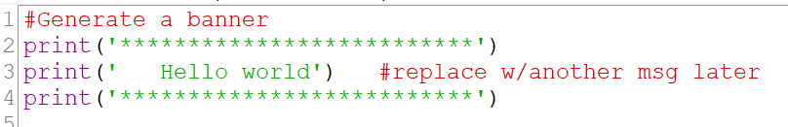
Comments cont.
While your comment lines will typically be on a line by itself, you may write a comment to the right of any line.
Notice that comment lines appear in red

Slide 19
Working with Variables

Slide 20
Variables
Variable - a name that represents a value stored in computer memory
Used to access and manipulate data stored in memory
Assignment statement – this creates a variable that references data in memory
Assignment operator: the equal sign (=)
variable = expression
Memory
age = 27
age
27

Slide 21
Variables: Naming Convention
Rules for naming Variables
Must start with a letter or an underscore
After the 1st character, may contain letters, digits, or underscores
Cannot contain spaces
Cannot be a Python keyword
Are case sensitive
Age and age are 2 different variables.
Use descriptive variable names
name = 'Sue'
a = 'Sue'
For multi-word variable names, you may use:
lowercase with underscores
dorm_name
num_internships
Camel Case
dormName, numInternships
Pascal Case
DormName, NumInterships
Note: in the textbook examples and these slides you might encounter non-descriptive variables names such a, b, c and x, y, z. However, do not use this approach in your code.

Slide 22

Variables can reference Literals
Recall that a literal is a hard-coded value
String Literal – a string that is hardcoded in a program.
Numeric Literal – a number that is hardcoded in a program.
Cannot contain currency symbols, nor commas!
prod_code = '12EF00'
prod_name = 'Pellegrino Mountain Bike'
category = 'Bicycles'
age = '27'
variable
string literal
prod_code
'12EF00'
Numbers are also string literals if enclosed in quotes
age = 27
gpa = 3.1
sales = 12333.99
Syntax Error!
sales = $12,333.99

Slide 23
Displaying a Variable
print() can display a literal or variable's value
Output
print('Bob')
Bob
Output
name = 'Bob'
print(name)
Bob
Output
age = 27
print(age)
27

Slide 24
Displaying Multiple Variables & Literals
print() function accepts multiple items (literals & variables)
The print function by default concatenates all arguments and inserts a blank between all values. Separate each argument with a comma
Output:
Arguments are displayed in the order they are passed to the print() function
The values are automatically separated by a space when displayed on screen
Output
quantity = 11
print('Quantity on hand:', quantity)
Quantity on hand: 11
name = 'Bob'
age = 27
print(name, 'is', age, 'years old.')
Output
Bob is 27 years old.

Slide 25
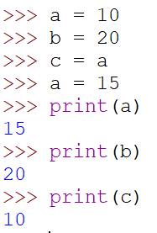
Variable Reassignment
Variables are not static.
They can be reassigned to a different value
They can be reassigned to another variable
age = 27
print(age)
age = 33
print(age)
Output
27
33
a = 10
b = 20
c = a
a = 15

Slide 26
More on IDLE

Slide 27
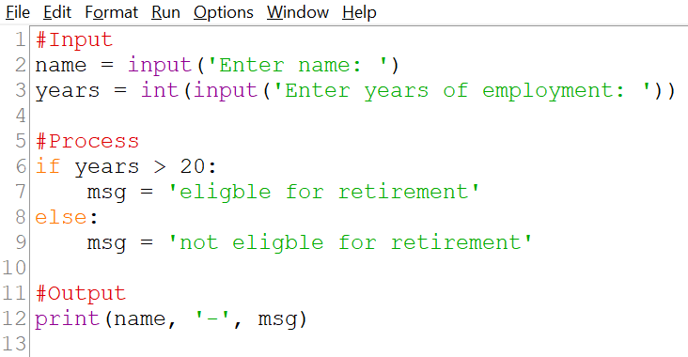
IDLE: Color Codes
Color | Item
Red | Comment lines: #Input
Orange | Python keywords: if, else, etc.
Green | String literals: ‘Enter name:’
Violet | Built-in functions: print(), etc.
Blue | Defined names: functions we will write later

Slide 28
IDLE: Keyboard Shortcuts
Standard
IDLE Specific
To Save your program, press: Ctrl+S
Select 1 or more lines first, then:
To Copy text, press: Ctrl+C
To Cut text, press: Ctrl+X
To Paste text, press: Ctrl+V
To Find text, press: Ctrl+F
To Replace text, press: Ctrl+H
To Select All text, press: Ctrl+A
To Run your code, press: F5 …or Fn+F5 on some laptops
Select 1 or more lines first, then:
To Comment lines, press: Alt+3 To Uncomment lines, press: Alt+4
To indent lines, press: Ctrl+] To dedent lines, press: Ctrl+[

Slide 29
Ch2 - Exercise 2: Literals & Variables

Slide 30
In the Shell Window…
Open IDLE and in the Shell Window type the following:
Displaying Output with String Literals – use print() to display
Display: Hello world
Display: The professor said "It's time to code"
Creating, Updating, and Displaying Variables
Create a variable named name and set it to: John Doe
Display the name variable
Create a variable named age and set it to: 19
Display the age variable
Update age to 20
Display the name and age variables in one statement

Slide 31
In the Text Editor Window…
Open IDLE, click File > New to open the Text Editor Window and type the following:
Working with String Literals
Add a comment line for this section
Display Hello world
Display Hello world. It’s me!
Save your program to your: P Drive > Ch2 > Lectures > Ch2-Ex02-Literals-and-Variables.py
Run it!
Working with String Variables
Add a comment line for this section
Create a variable named first_name and set it to: John
Create a variable named last_name and set it to: Doe
Display the first_name and last_name variables in one statement: John Doe
Display the first_name variable with a label like this: First name: John
Display the last_name variable with a label like this: Last name: Doe
Save your program & run it!

Slide 32
Exercise cont.
…continue working in the Ch02-Ex2-Literals-and-Variables.py file on your P Drive
Working with Numeric Variables
Add a comment line for this section
Create a variable named age and set it to: 19
Create a new variable (prev_age) that grabs the value of the age variable
Update age to 20
Display the prev_age and age variables on one line like this: Age – previous: 19 current: 20
Save your program & run it!
Now, make your final output look like this…
Printing String Literals
----------------------------
Hello world
Hello world. It’s me!
Printing String Variables
----------------------------
John Doe
First name: John
Last name: Doe
Printing Numeric Variables
----------------------------
Age - previous: 19 current: 20

Slide 33
Exercise cont.
…continue working in the Ch02-Ex2-Literals-and-Variables.py file on your P Drive
Practice Keyboard shortcuts
Select the 1st section of code and comment them out & Run!
Re-select those lines & uncomment
Select a few lines & indent
Select a few lines & remove the indent
Make sure you do not leave any indented lines because indenting means something in Python and we are not ready to use this feature.

